Slide 1
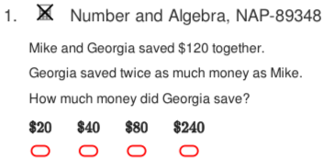
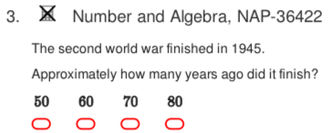
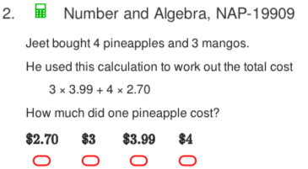
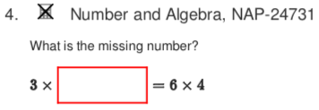
Naplan Starter Questions

Slide 2
My Numbers and Operations Interactive Notebook
$$+$$
$$23$$
-1
$$−$$
$$×$$
$$÷$$
Name:
Class:
Teacher:
Semester 1
Term 1
$$5^{2}$$
$$0$$
$$−10$$

Slide 3

Interactive Notebooks!
Cover Page
Contents Page
Glossary
24/7/30
EQ
Questions
Notes
Summaries
Work page
Presentation!!!
Your book, your responsibility!

Slide 4


Slide 5
Contents
Glossary or Formula Page
Page
Date
Description
2
3

Slide 6

Learning Intentions
To learn a bit about the history of number systems✓
To further expand and solidify our mathematical vocabulary✓
To further learn the value of the place system ✓
To compare, order, add and subtract integers
WICOR

Slide 7
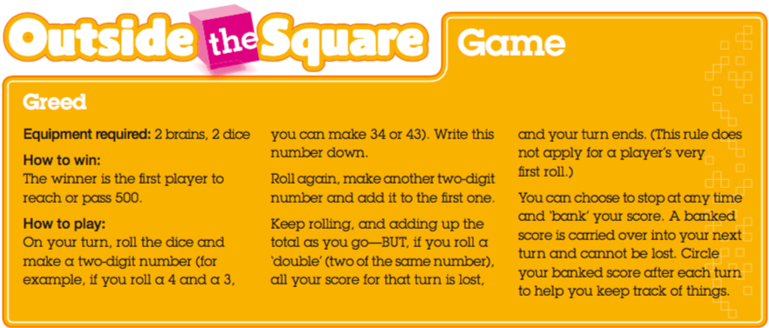

Slide 8
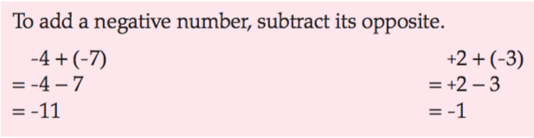

24
7
30
Simplifying Adding and Subtracting of Integers
Date
EQ – What are the rules for adding and subtracting negative integers?
By now, we should all have a personal number line glued into our INBs. If you don’t, grab one from me and glue it into your book.
Adding negative integers:
Ex:
Summary:

Slide 9

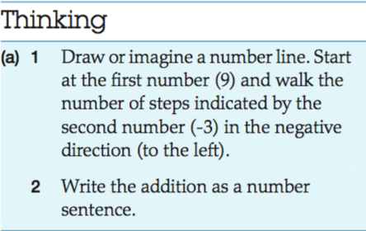
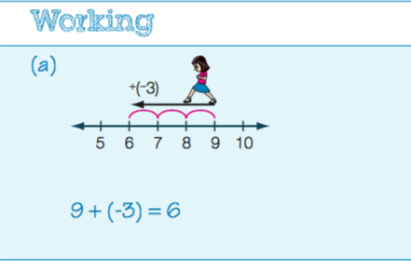
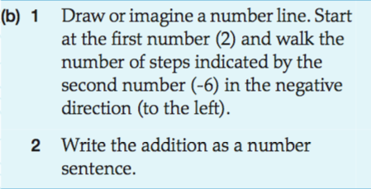
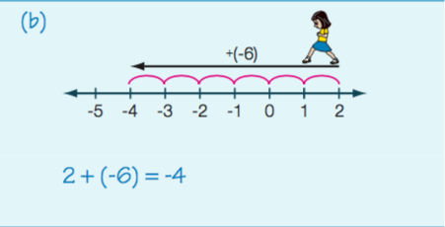
24
7
30
Simplifying Adding and Subtracting of Integers
Date
EQ – What are the rules for adding and subtracting negative integers?

Slide 10
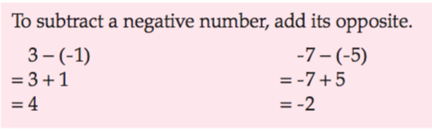

24
7
30
Simplifying Adding and Subtracting of Integers
Date
EQ – What are the rules for adding and subtracting negative integers?
Subtracting negative integers:
Ex:

Slide 11
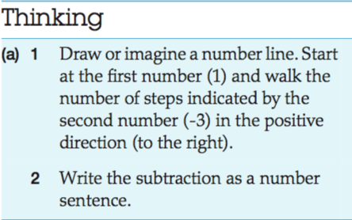
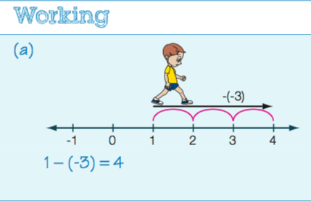
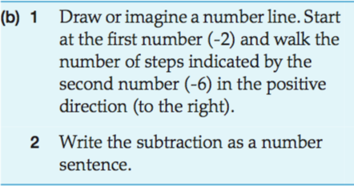
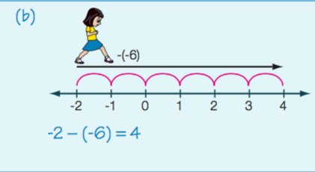
24
7
30
Simplifying Adding and Subtracting of Integers
Date
EQ – What are the rules for adding and subtracting negative integers?

Slide 12
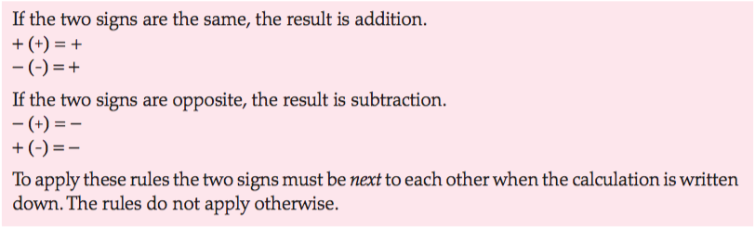
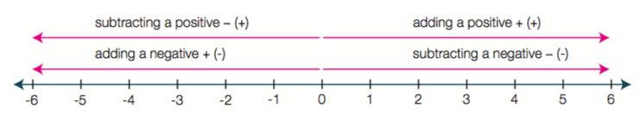
24
7
30
Simplifying Adding and Subtracting of Integers
Date
EQ – What are the rules for adding and subtracting negative integers?
The Rules for addition and subtraction:
Remember this!!!

Slide 13

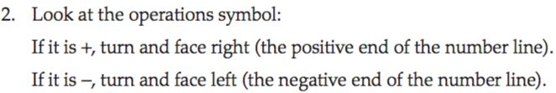
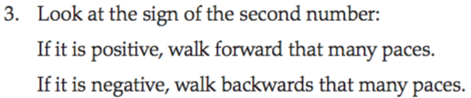
24
7
30
Simplifying Adding and Subtracting of Integers
Date
EQ – What are the rules for adding and subtracting negative integers?

Slide 14

Do you understand? Fists of Five
Notes:
Check for Understanding

Slide 15
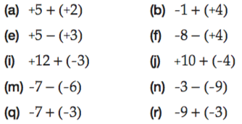

Your Turn

Slide 16
Classwork/Homework
The Ultimate Cool Worksheet

